Slide 1
FACTOR DEMAND

Slide 2
FACTOR MARKETS VIDEO SERIES
Carefully view each of these ACDCL videos prior to viewing this powerpoint:
https://www.youtube.com/watch?v=Y2Z9r4PKwI8&list=PL50F9C4FD0BE8FE28

Slide 3
Factors of production
Prices for the FOPs help firms to decided HOW to product their good/service.
If fast-food workers gain raises, ceteris paribus, it would be reasonable to expect firms to adjust the mix of FOPs to substitute more capital for labor, in future expansion.

Slide 4
1. Factors need create more value than their cost
A firm will benefit from hiring a unit of labor (or any FOP), only if the value of their production is greater than the cost of employing the resource.
Price of the product x marginal product (of labor) = VMPL (value of marginal product to labor)
Price of the product is essential: the world’s most productive worker is useless to a firm, if they produce something that isn’t valued by consumers.

Slide 5
VMPL
Is the total monetary benefit of hiring a worker.
= P x MP
Calculate MP
& VMPL:
Price = $2.
If the wage rate is $8, how many workers should be hired?
Labor units | Total Product | Marginal Product | VMPL
2 | 18 | 10
3 | 26 | 8
4 | 32 | 6
5 | 36 | 4

Slide 6
Maximizing Profits: how many workers?
If VMPL >= W the firm will hire
If VMPL < W the firm will not hire
If W = $8, the firm would hire 5 workers. The VMPL of the fifth worker is $8.

Slide 7
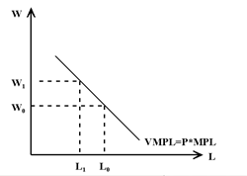
VMPL is demand for labor (for this firm). A firm will adjust the quantity it demands when wages (prices) change.

Slide 8
What causes demand for labor to shift?
Only external variables impact supply & demand. Never prices/costs.
Changes in the supply (price) of other factors:
Land and capital. An increase in supply of capital would increase labor MP, so increasing demand for labor.
Changes in technology
New tech boosts productivity among labor. Increasing demand for labor.
Changes in the prices of goods produced by the firm.
An increase in price for lemonade, will reduce a firms demand for labor.

Slide 9
2. Land & Capital Markets
The demand for land and capital is ‘derived demand’, meaning it is based on the demand for the products created by these FOPs.
Firms maximize profit by hiring land/capital up to the point where the MP gained is equal to the factor price paid.

Slide 10
Rent = explicit cost of land/capital
Land supply relatively price inelastic
Capital supply more price elastic

Slide 11
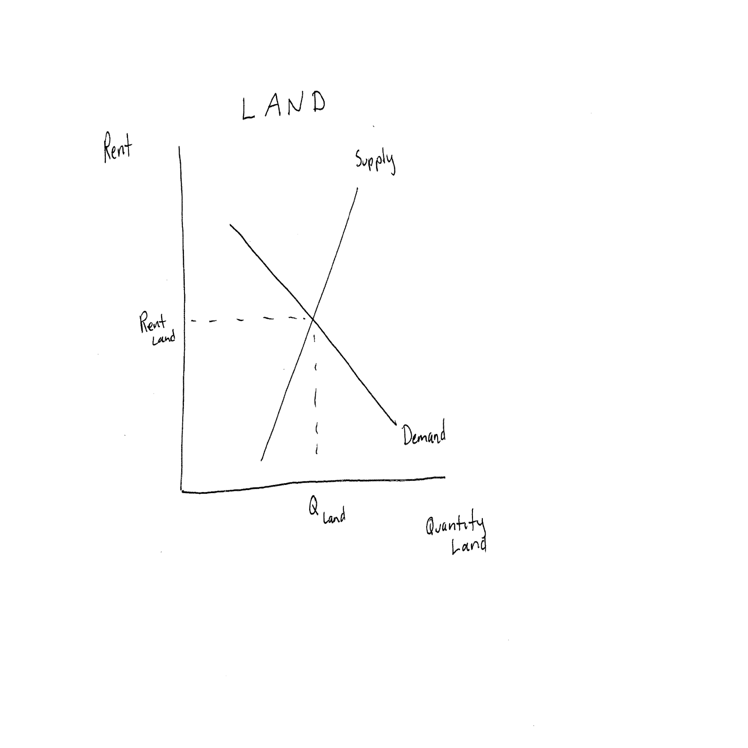
Price inelastic supply of land

Slide 12
Relatively price elastic capital supply

Slide 13
Marginal Productivity Theory of Income Distribution:
Each factor is paid the value of output generated by the last unit of that factor.
The last unit of capital, land or labor employed is paid a wage equal to the value of it’s marginal product.

Slide 14
3. Market for Labor
Why do people work: they want to consume.
Why do people spend time not working: leisure
Preferences and cultural practices give rise to a labor supply.
????? Would you work more if higher wages were paid? How much more?

Slide 15
Backward bending labor supply curve:
Assumption: leisure is a ‘normal good’ (when income rises we want more of it)
When wages rise from w1 to w2, quantity of labor supplied rises. People will substitute more labor for what was leisure time.
When wages rise from w2 to w3, quantity supplied drops. The higher wage increases demands for more leisure time.

Slide 16
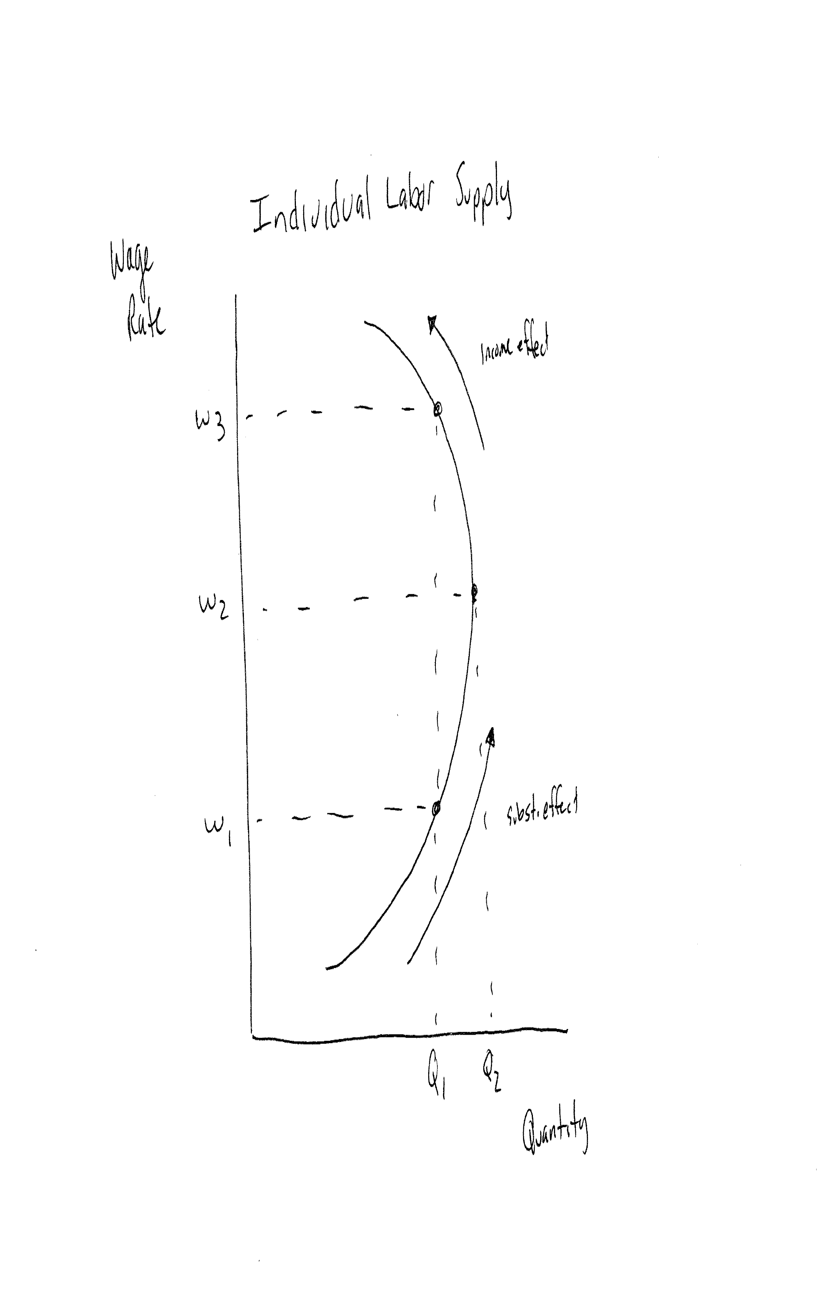
Individual Labor Supply

Slide 17
What shifts labor supply?
Changes in
Preferences/norms: women & minorities ability to work. Cultural stances of thrift v consumerism, industry v. free-time
Population
Wealth: greater wealth will reduce supply

Slide 18
4. FACTOR DEMAND in uncompetitive markets
Recall, imperfect competition means that firms have ability to set prices. Perfect competition is price-taker.
Price = MR (perf comp)
Price > MR (imperect competition)

Slide 19
In perfect competition, firms hire until the value of the marginal benefit = marginal cost of employing the resource.
VMPL = P*MPlabor = Wage
The same is true in imperfect competition EXCEPT: the marginal benefit is not determined by price, but by MR.
To determine it’s demand for workers, the monopolist multiplies the MPlabor by the MR received from selling the additional output, called marginal revenue product of labor.
MRPL = MPL x MR

Slide 20
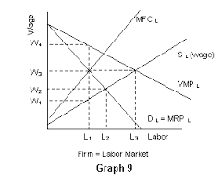
Imperfect Comp: Demand for labor would be smaller.
Since MR < P,
MRPl<
VMPl
At any wage, perf
Comp would demand
Larger quantity labor

Slide 22
Imperfect Competition

