Slide 1
INTRO TO ECONOMIC SYSTEMS

Slide 2
THERE ARE DIFFERENT WAYS TO ANSWER THE THREE ESSENTIAL QUESTIONS : (regarding resource allocation) 1. What to produce 2. How to produce 3. For whom to produce

Slide 3
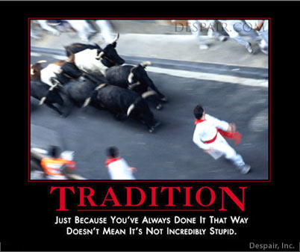
System 1: Traditional Systems
Things remain as they have been.

Slide 4
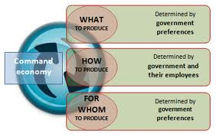
System 2: Planned Systems
Decision making highly centralized
Leadership appoints committees to determine what/how/for whom.
First come/first serve.
Property is communally owned
The state can equitably distribute output

Slide 5
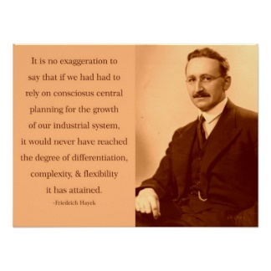
F. Hayek, ‘Austrian School of Econ and leading critic of planning

Slide 6
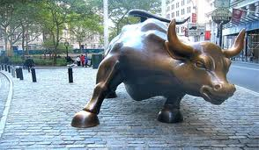
System 3: Market Capitalism
Highly decentralized.
Interaction of many producers and consumers
Prices direct all traffic
Private property exists.

Slide 7
How Capitalism work:
Private Property:
Property owners have an incentive to preserve and maximize the value of their property.
Assumption 1: individuals act rationally
Assumption 2: individuals act to maximize self-benefit
Therefore, all resources will be used to maximize production

Slide 8
“It is not from the benevolence of the butcher, the brewer, or the baker that we expect our dinner, but from their regard to their own interest…” -Adam Smith describes the invisible hand

Slide 9
How do property owners know what is the best use of their resources?
***PRICES!***
In a market economy, prices are a mechanism that plays conductor for all economic activity.

Slide 10
Price Mechanism:
Prices are determined by the interaction of millions of individual consumers & producers. Prices act as a mechanism for directing all economic activity in a market economy (consumption/production/etc.).

Slide 11
Price Mechanism 3 Functions:
Signaling Function:
Prices adjust to signal where resources are needed.
Prices rise and fall to remedy shortage and surpluses.
Prices up = MORE RESOURCES NEEDED (Ceteris Paribus)
Prices down = FEWER RESOURCES NEEDED (CP)

Slide 12
3 Functions cont.:
2. Transmission of Preferences:
Consumers, through their choices, send info to producers about what they want/need.
Consumers want it = prices go up (ceteris paribus)
Consumers don’t want it = prices go down (CP)

Slide 13
3 functions cont.:
3. Incentivizing:
When prices adjust, consumers and firms have an incentive to respond in manner that harnesses their instinct for profit & self-benefit.
Consumers (some) will respond to higher home prices and producers (many) will to.

Slide 14
Prices and OpCosts
All choices have opportunity costs.
Price allows us to understand the opcost of our decision when thinking about consuming.
When house prices are “too high”, what that actually means is you are unwilling to give up all the other stuff you could consume if you were to buy a home.
When prices drop, opcost drops – you have to give up less stuff to get the good.

Slide 15
Breakdown
Private property will be used to maximize production by individuals who are profit-maximizers. (productive effeciency)
Prices signal, transmit preferences, incentivize producers and consumers to allocate resources to their best use. (allocative efficiency)
Millions of decision makers interact & the price mechanism directs activity so…
A city like Paris gets to eat every day, and when tastes change… the market delivers.

Slide 16
Without private property, individuals have no incentive to risk, produce, innovate, preserve.
(tragedy of the commons)
Without a functioning price system, consumers and producers have no way of knowing what to produce, how they should produce it, or who should get what is produced.

Slide 17
Will we ever run out of oil?
Use your knowledge of the market and price system to answer the question. Use a PPF graph in your answer.

