Slide 1
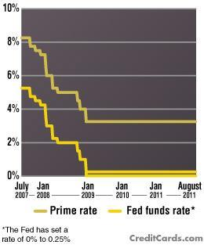
The Money Market & The Fed
Investment Demand Review &

Slide 2
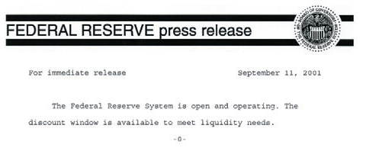

Slide 3
What does the Fed target?
FOMC: Target is Federal Funds Rate via Open-Market Operations (OMO).
Federal Funds Rate: Bank-to-Bank short-run loan rate is a product of the excess reserves of individual banks.
The Fed controls the money supply and excess reserves AND, thus, the interest rate in the short run.
Primary Dealers of New York Fed OMO.

Slide 4
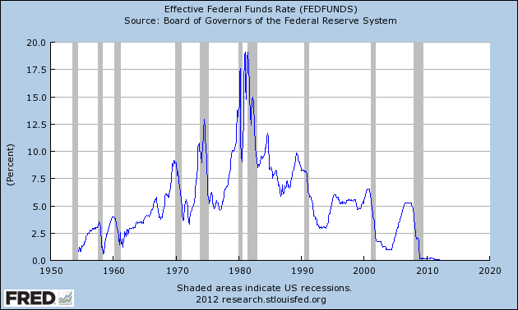
Target Rate: Federal Funds Rate

Slide 5
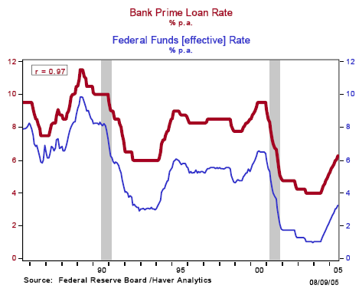
Note: Relationship and Flashback Rates

Slide 6
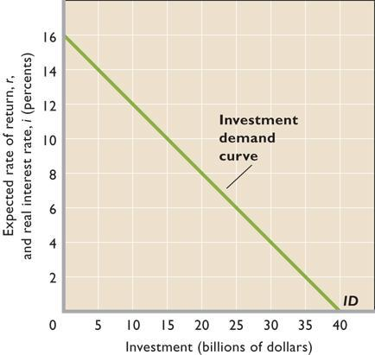
Investment Demand (review)
The graph shows the relationship when the investment rule is followed. Fewer projects are expected to provide high return, so less will be invested if interest rates are high.
Investment moves the AD Curve:
GDP = C + I + G + Nx

Slide 7
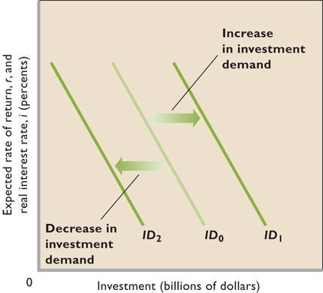
Investment Demand (review)
Shifts in investment demand occur when any determinant apart from the interest rate changes.
Ex., Greater expected returns create more investment demand; shift curve to right. The reverse causes a leftward shift.

Slide 8
The Money Market
The market where the Fed and the users of money interact thus determining the nominal interest rate (i%).
Money Demand (MD) comes from households, firms, government and the foreign sector.
The Money Supply (MS) is determined only by the Federal Reserve.

Slide 9
Money Demand
Transaction Demand – demand for money as a medium of exchange (independent of the interest rate). Ex, need cash for milk, gas, meds etc.
Asset Demand – demand for money as a store of value (dependent on the interest rate). Ex, the opportunity cost of holding cash as an investment.
Total Money Demand – (MD) is downward sloping because at high interest rates people are less inclined to hold money and more inclined to hold stocks & bonds. At lower interest rates people sacrifice less when they hold money.

Slide 10
Money Supply
The money supply is determined by the Federal Reserve because the Fed has monopoly control over the supply of money.

Slide 11
The Money Market (Draw)
i%
MS
i
MD
Q
Q_{M}
The equilibrium of MS & MD determines the nominal interest rate (i%). MD is downward sloping because the nominal interest rate is the opportunity cost of holding money. MS is vertical because it is independent of the interest rate.

Slide 12
Changes in Money Demand
Money Demand is dependent on both the Price Level and Real GDP which together comprise the Nominal GDP
Nominal GDP↑ .: MD→ .: i%↑ (nominal interest rate)
Nominal GDP↓ .: MD← .: i%↓

Slide 13
Increase in Money Demand (Draw)
i%
MS
→
i₁
→
→
MD₁
i
MD
Q
Q_{M}
MD→ .: i%↑

Slide 14
Decrease in Money Demand (Draw)
i%
MS
←
i
→
←
MD
i₁
MD₁
Q
Q_{M}
MD← .: i%↓

Slide 15
Changes in the Money Supply
Only the Fed determines the money supply.
The Two Monetary Policy Options :
1) expansionary or 2) contractionary monetary policy.
Expansionary Monetary Policy
MS→ .: i%↓
Contractionary Monetary Policy
MS← .: i%↑

Slide 16
Increase in Money Supply (Draw)
i%
MS
MS₁
→
i
→
→
i₁
MD
Q
Q₁
Q_{M}
MS→ .: i%↓

Slide 17
Decrease in Money Supply (Draw)
i%
MS₁
MS
←
i₁
→
←
i
MD
Q₁
Q
Q_{M}
MS← .: i%↑

Slide 18
Target Rate: Federal Funds Rate

Slide 19
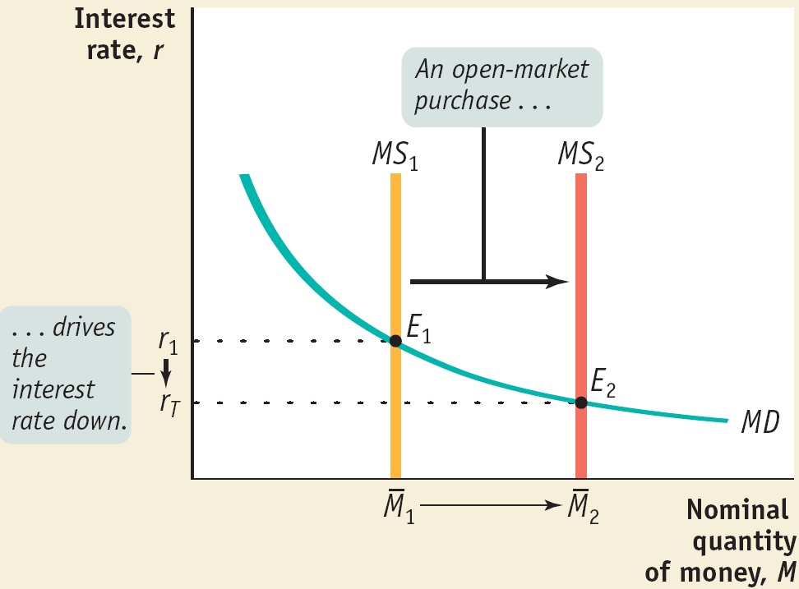
Setting the Federal Funds Rate - Pushing the Interest Rate Down to the Target Rate
The target federal funds rate is the Federal Reserve’s desired federal funds rate.
*
Notes:
*

Slide 20
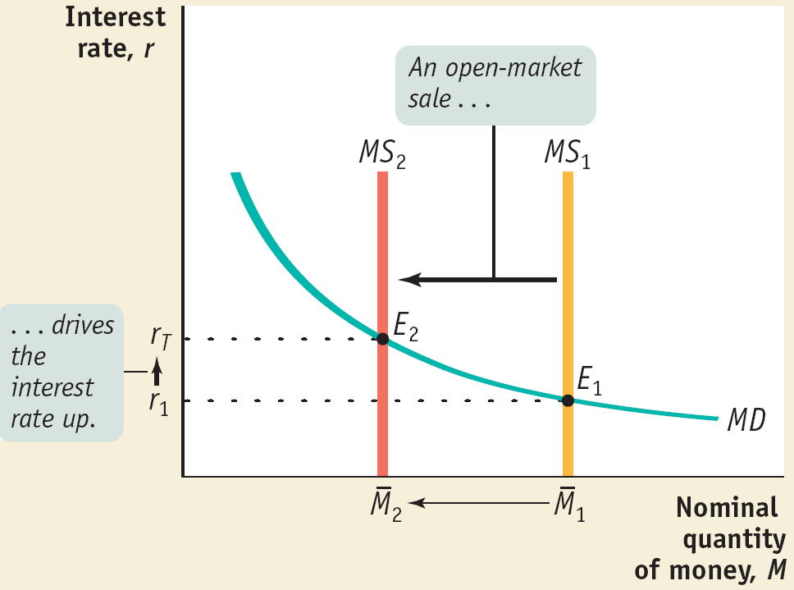
Setting the Federal Funds Rate - Pushing the Interest Rate Up to the Target Rate
*
Notes:
*

Slide 21
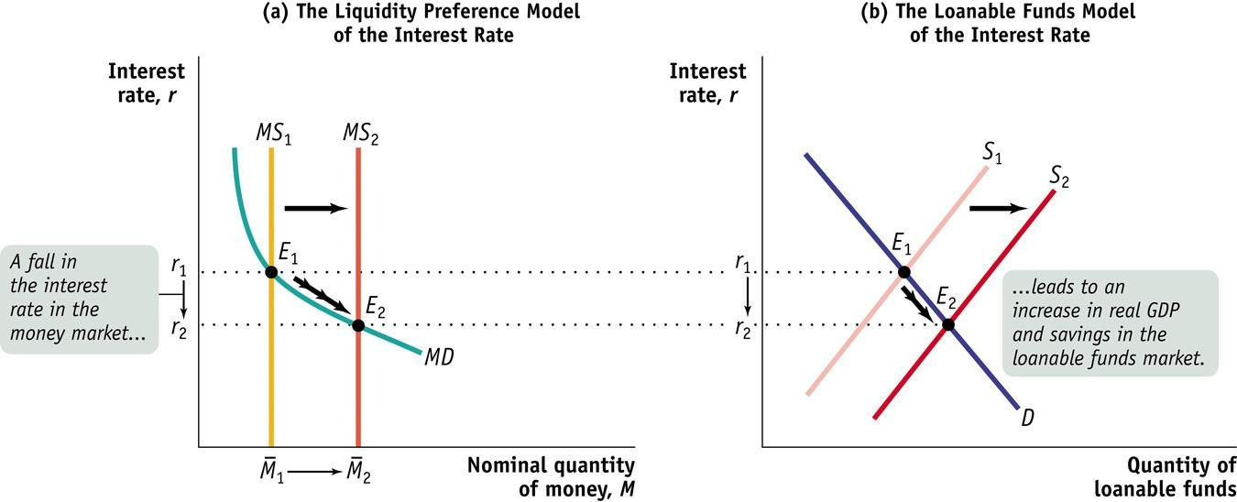
The Short-Run Determination of the Interest Rate
*
Notes:
*
Panel (a) shows the liquidity preference model of the interest rate: the equilibrium interest rate matches the money supply to the quantity of money demanded. In the short run, the interest rate is determined in the money market, where an increase in the money supply from M1 to M2 pushes the equilibrium interest rate down from r1 to r2.
Panel (b) shows the market for loanable funds model of the interest rate. The fall in the interest rate in the money market leads, through the multiplier effect, to an increase in GDP and savings; to a rightward shift of the supply curve of loanable funds, from S1 to S2, and to a fall in the interest rate, from r1 to r2. As a result, the new equilibrium interest rate in the loanable funds market matches the new equilibrium interest rate in the money market at E2.

Slide 22
Long-run: Monetary Neutrality
In the long run, changes in the money supply affect only the aggregate price level but not real GDP or the interest rate.
Monetary Neutrality: changes in the money supply have no real effect on the economy.
Monetary policy is ineffectual in the long run.
Monetary policy only works in the short run!

Slide 23
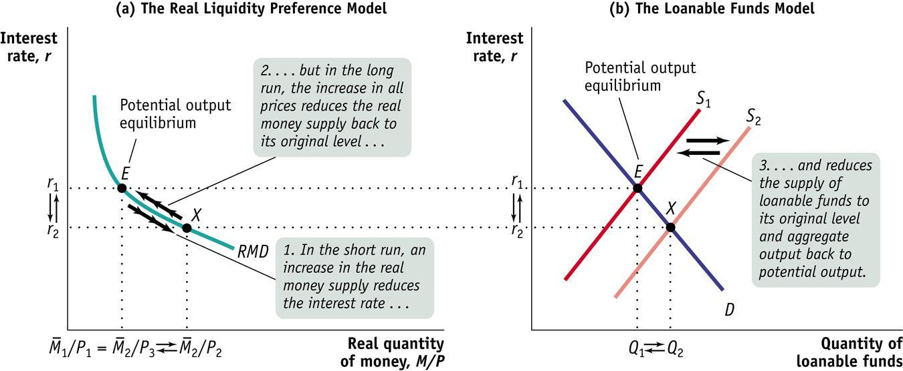
The Long-Run Determination of the Interest Rate
*
Notes:
*
Panel (a) shows the money market expressed in real terms and panel (b) shows the loanable funds market. Each market starts at point E, where the economy is at potential output. In the short run, an increase in the money supply increases the real money supply from M₁/P₁ to M₂/P₂ and reduces the equilibrium interest rate from r1 to r2 as the money market moves from point E to point X. The fall in the interest rate leads to higher real GDP and higher savings through the multiplier effect. This shifts the supply curve of loanable funds rightward, from S1 to S₂, also moving the market for loanable funds from point E to point X. In the long run, however, the increase in the money supply raises prices: the real money supply returns to its original level, M2/P3 = M1 /P1, and the supply curve of loanable funds shifts back to its initial position, S₁. So in the long run, the equilibrium interest rate is determined by the supply and demand for loanable funds that arise at potential output.

Slide 24
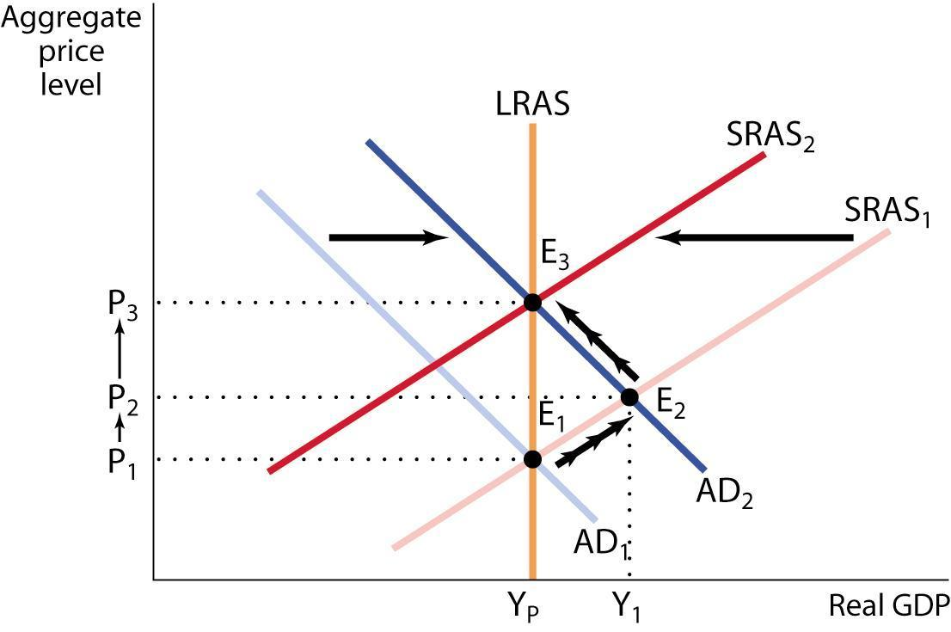
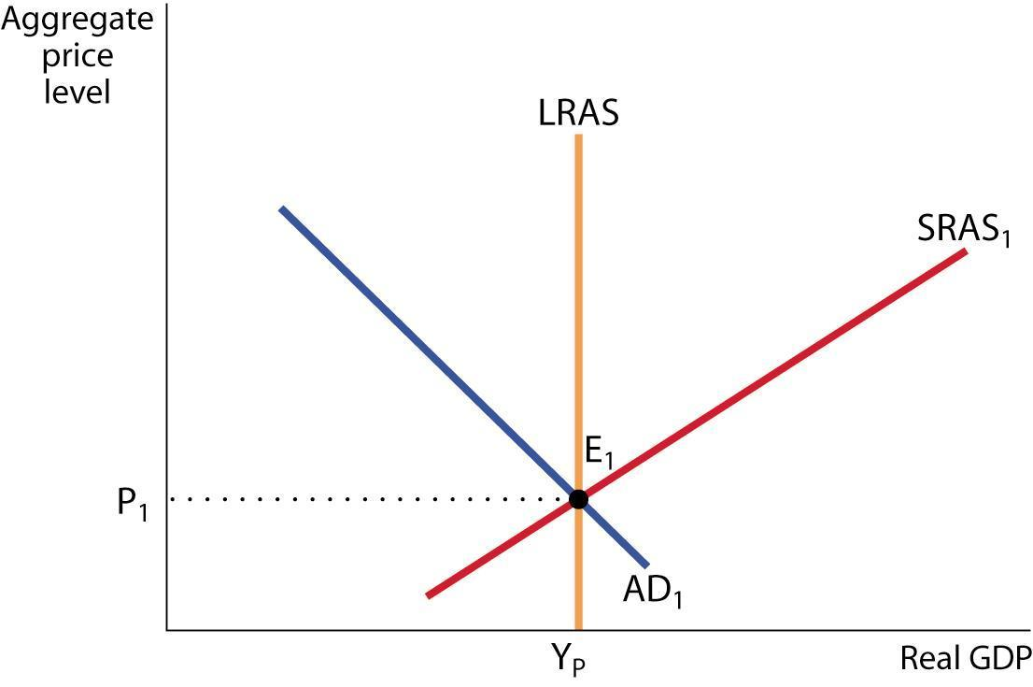
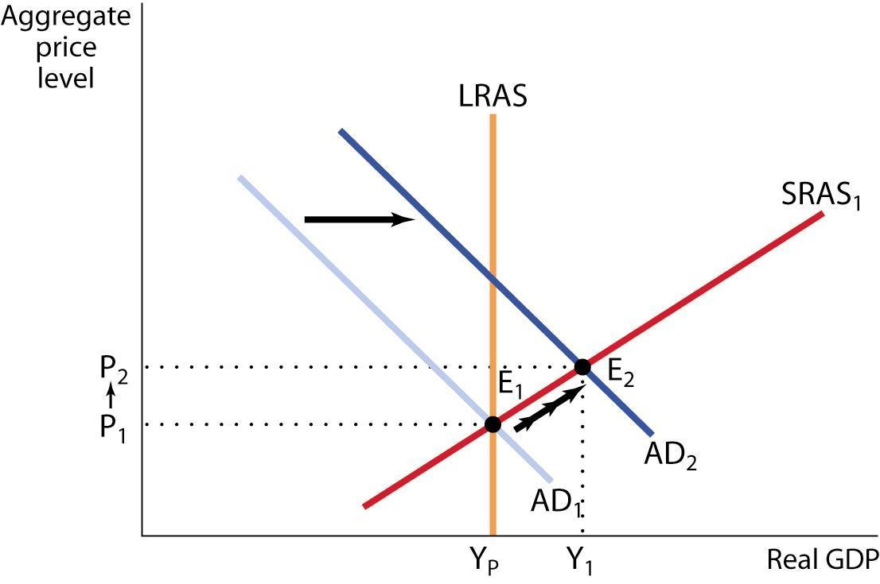
Money and Prices
According to the classical model of the price level, the real quantity of money is always at its long-run equilibrium level.
*
Notes:
*
Starting at E1, an increase in the money supply shifts the aggregate demand curve rightward, as shown by the movement from AD1 to AD2. There is a new short-run equilibrium at E2 and a higher price level at P2. In the long run, nominal wages adjust upward and push the SRAS curve leftward to SRAS2. The total percent increase in the price level from P1 to P3 is equal to the percent increase in the money supply. In the classical model of the price level, we ignore the transition period and think of the price level as rising to P3 immediately. This is a good approximation of the conditions of high inflation.

Slide 25
How does this all fit together?
Money Market, Investment Demand, AS/AD

Slide 26
i%
MS
MS₁
i%
Graphing Expansionary Monetary Policy
→
i
i
→
→
→
i₁
i₁
MD
ID
→
Q
Q₁
Q_{M}
I
I₁
I_{G}
Fed buys bonds, TAF loan,
Lower discount rate
.: ER↑ .: MS→ .: i%↓
.: I_{G}↑
.: AD→.: GDP_{R}↑ & PL↑
.: u%↓ & π%↑
LRAS
PL
→
SRAS
P₁
→
P
AD₁
→
AD
Y
Y_{F}
GDP_{R}

Slide 27
Paul Solman Video
Macro_moneypol.mov

