Slide 1
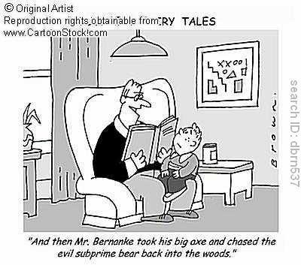
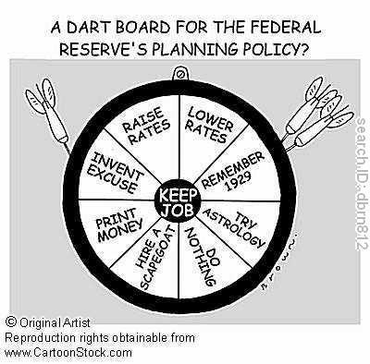
Monetary Policy
NEW YORK FED COMIC BOOK (PDF) ON MONETARY POLICY

Slide 2
Monetary Policy
Central bank (The Fed, Bank of Japan, ECB, Bank of England…) efforts to promote:
full employment,
maintain price stability,
and encourage long-run economic growth through control of the money supply and interest rates.

Slide 3
Monetary Policy Analogy
Fed : Capitalist Economy AS Driving Instructor : Hormonal 15 year old Student Driver

Slide 4
Types of Monetary Policy
Expansionary
(Easy Money)
Monetary policy designed to counteract the effects of recession and return the economy to full employment.
Expansionary = Buy Bonds!
Contractionary
(Tight Money)
Monetary policy designed to counteract the effects of inflation and return the economy to full employment.
Contractionary = Sell Bonds!

Slide 5
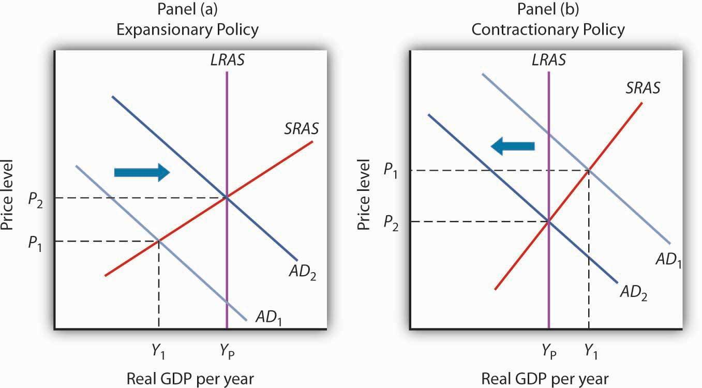
Monetary Policy = Interest Rate Control

Slide 6
Four Tools of Monetary Policy
1) Required Reserve Ratio
2) The Discount Rate
3) Open Market Operations (OMO)
Selling/Buying of treasuries to target the Fed. Funds Rate.
4) Term Auction Facility (TAF)

Slide 7
1) The Required Reserve Ratio
The % of demand deposits that must be stored as vault cash or kept on reserve as Federal Funds in the bank’s account with the Federal Reserve.
The Required Reserve Ratio determines the money multiplier ( ¹/_{reserve ratio})
Decreasing the reserve ratio increases the rate of money creation in the banking system and is expansionary.
Increasing the reserve ratio decreases the rate of money creation in the banking system and is contractionary.
Changing the required reserve ratio is the least used tool of monetary policy and is usually held constant at 10%.

Slide 8
2) The Discount Rate
The interest % banks pay the Fed for overnight loans in order to meet the required reserve
Decreasing the discount rate lowers the cost of borrowing for banks, thus creating an incentive for banks to loan more of their excess reserves and borrow from the Fed in order to meet their reserve requirement or contractual clearance balance. The effect is to increase the money supply and is therefore expansionary.
Increasing the discount rate raises the cost of borrowing for banks, thus creating an incentive for banks to loan less of their excess reserves. The effect is to decrease the money supply and is therefore contractionary.
The discount rate is a secondary tool of monetary policy. It functions as a substitute to the Fed Funds market, providing banks with necessary liquidity when they are unable to access Fed Funds from other private sector banks. However, banks are often reluctant to utilize the discount window because it looks desperate. The Fed is the “Lender of Last Resort.”
The discount rate is usually higher than the fed funds rate.

Slide 9
3) Open Market Operations
The purchase and sale of government securities by the Fed in order to increase or decrease banks’ excess reserves. OMO determines the Fed Funds rate, which is the interest % banks pay each other for overnight loans of Federal Funds
When the Fed buys bonds, excess reserves in the banking system increase and is therefore expansionary.
When the Fed sells bonds, excess reserves in the banking system decrease and is therefore contractionary.
OMO is the primary tool of monetary policy.

Slide 10
4) Term Auction Facility (TAF)
Instituted in December 2007 in response to a crisis in the Fed Funds market and a reluctance of banks to utilize the Fed’s discount window. Under the TAF, banks can competitively bid against each other on collateralized 28 day loans from the Fed in incremental amounts from $10 million to $3 billion. The total amount of funds available for auction are determined prior to the auction by the Fed. The purpose of the TAF is to ensure bank liquidity without the perceived downsides of utilizing the discount window.
The Term Auction Facility is a tool of expansionary monetary policy.
The interest rate on a TAF loan (stop-out rate) is most likely between the fed funds rate and the discount rate.

Slide 11
Why do banks need overnight loans?
Banks are like any other business in that they seek to maximize profits. Banks make a profit by loaning out as much of their excess reserves as possible and charging interest to the borrower. If, in the course of business, they have loaned out all excess reserves and do not have enough money to satisfy the required reserve ratio or their contractual clearing balance, then they must either borrow from the Fed’s discount window, borrow from the Fed through the TAF, or most likely borrow from each other in the Fed Funds market .

Slide 12
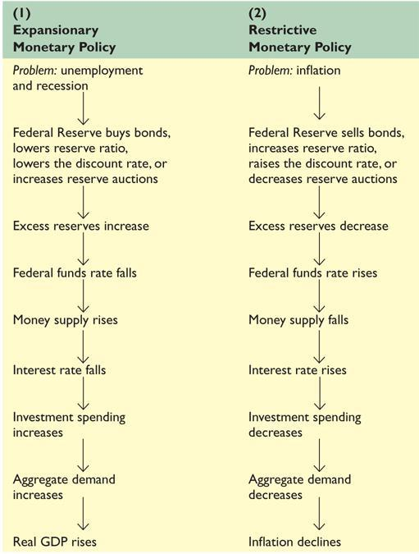

Slide 13
i%
MS
MS₁
i%
Graphing Expansionary Monetary Policy
→
i
i
→
→
→
i₁
i₁
MD
ID
→
Q
Q₁
Q_{M}
I
I₁
I_{G}
Fed buys bonds, TAF loan,
Lower discount rate
.: ER↑ .: MS→ .: i%↓
.: I_{G}↑
.: AD→.: GDP_{R}↑ & PL↑
.: u%↓ & π%↑
LRAS
PL
→
SRAS
P₁
→
P
AD₁
→
AD
Y
Y_{F}
GDP_{R}

Slide 14
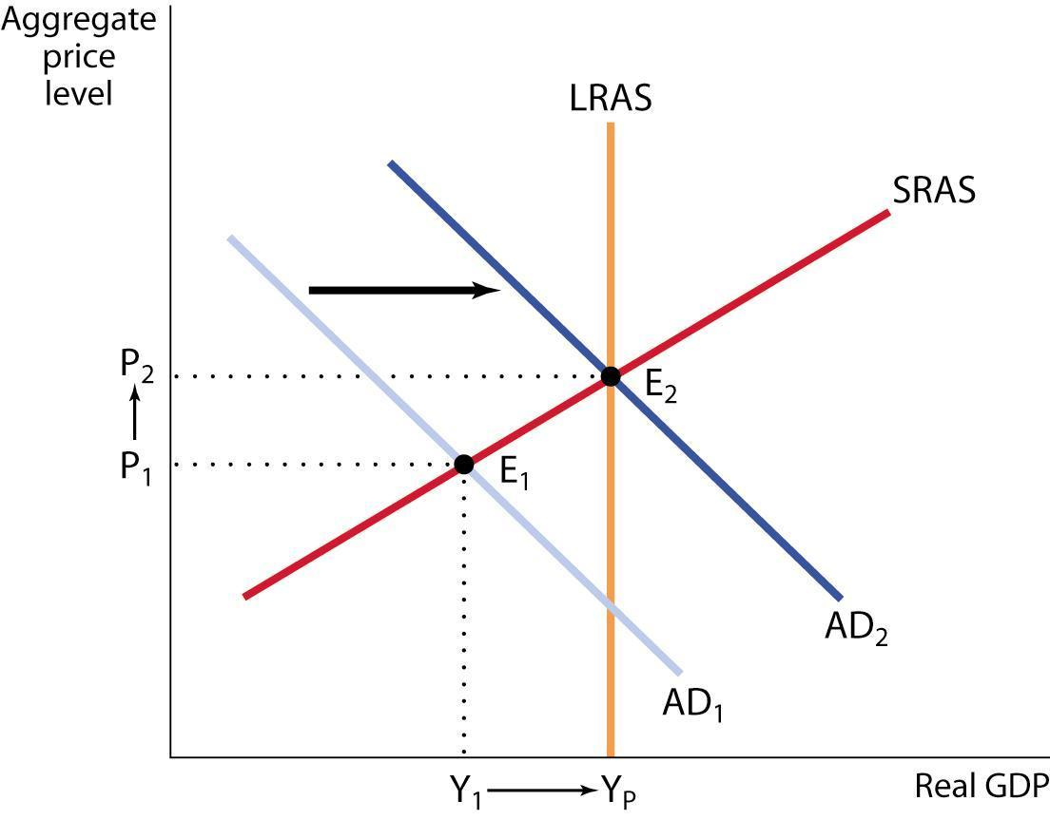
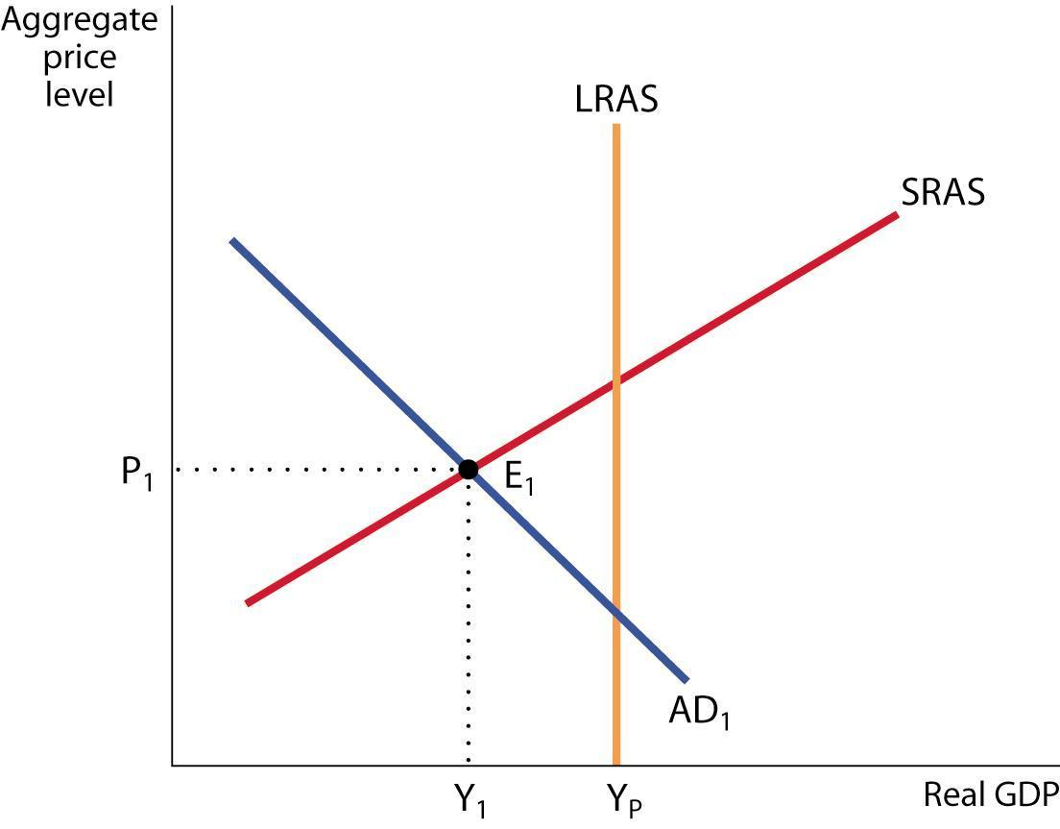
Expansionary Monetary Policy
Expansionary Monetary Policy Can Close a Recessionary Gap
Expansionary monetary policy increases aggregate demand.
Recessionary Gap
*
Notes:
*
At E₁ the economy is in short-run equilibrium where the aggregate demand curve AD₁ intersects the SRAS curve. At E₁, there is a recessionary gap of Y_{E} − Y₁. An expansionary fiscal policy—an increase in government purchases, a reduction in taxes, or an increase in government transfers—shifts the aggregate demand curve rightward. It can close the recessionary gap by shifting AD₁ to AD₂, moving the economy to a new short-run equilibrium, E₂, which is also a long-run equilibrium.

Slide 15
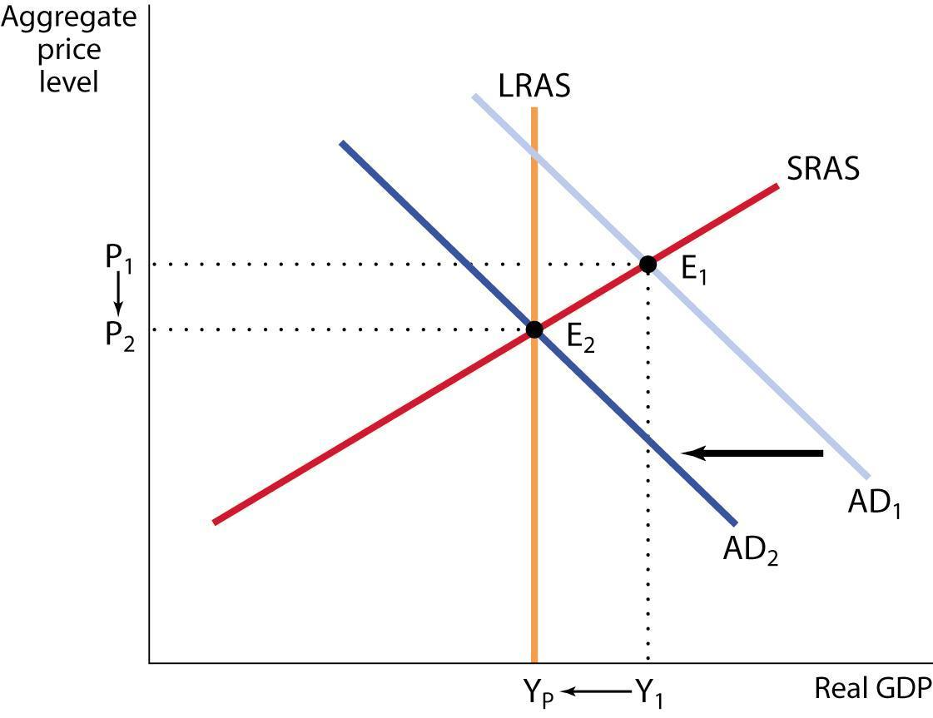
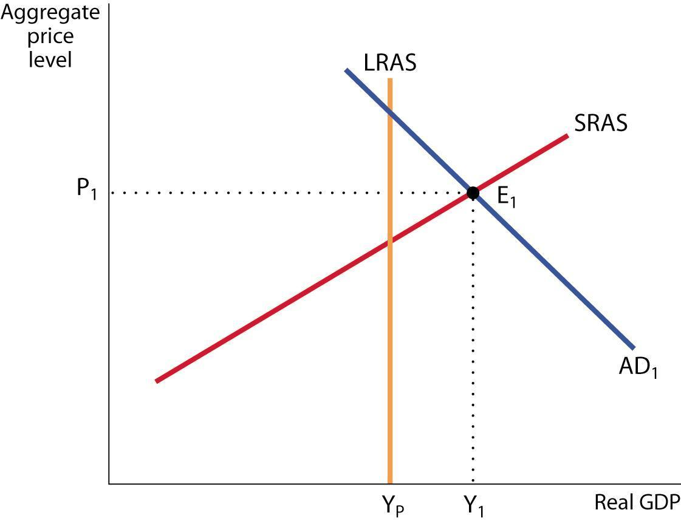
Contractionary Monetary Policy
Contractionary Monetary Policy Can Eliminate an Inflationary Gap
Contractionary monetary policy decreases aggregate demand.
Inflationary Gap
*
Notes:
*
At E₁ the economy is in short-run equilibrium where the aggregate demand curve AD₁ intersects the SRAS curve. At E₁, there is an inflationary gap of Y₁ − Y_{E} . A contractionary fiscal policy—reduced government purchases, an increase in taxes, or a reduction in government transfers—shifts the aggregate demand curve leftward. It can close the inflationary gap by shifting AD₁ to AD₂, moving the economy to a new short-run equilibrium, E₂, which is also a long-run equilibrium.

Slide 16
Paul Solman Video
STEER_FED.MOV
IF TIME. IF NOT, MOVE TO SHORT BONDS PP.

Slide 17
Expansionary Monetary Policy to Counteract a Recession w/ reinforcing effect on Net Exports
→
→
→
→
Res. Ratio
Disc. Rate
Buy Bonds
TAF
ER ,therefore MS causing i% which leads to I_{G}
=
→
→
→
→
so AD ,resulting in PL and GDP_{R} ,making u%
→
→
←
→
And now! Because i% either D$ or S$ which causes $ making U.S. goods
relatively and foreign goods relatively causing X and
M which means X_{N} thereby reinforcing the increase in AD already caused by
the increase in I_{G.}
→
←
cheaper
more expensive
→
→
→
AD = Aggregate Demand
PL = Price Level
GDP_{R} = Real Gross Domestic Product
u% = Unemployment Rate
S$ = Supply of Dollars in FOREX
M = Imports, X_{N} = Net Exports
ER = Excess Reserves
MS = Money Supply
i% = Nominal Interest Rate
I_{G} = Gross Private Investment
D$= Demand for dollars in FOREX
X = Exports

Slide 18
Contractionary Monetary Policy to Counteract Inflation w/ reinforcing effect on Net Exports
Res. Ratio
Disc. Rate
Sell Bonds
→
→
→
→
ER ,therefore MS causing i% which leads to I_{G}
=
→
→
→
→
so AD ,resulting in PL and GDP_{R} ,making u%
→
→
←
→
And now! Because i% either D$ or S$ which causes $ making U.S. goods
relatively and foreign goods relatively causing X and
M which means X_{N} thereby reinforcing the decrease in AD already caused by
the decrease in I_{G.}
→
←
more expensive
cheaper
→
→
→
AD = Aggregate Demand
PL = Price Level
GDP_{R} = Real Gross Domestic Product
u% = Unemployment Rate
S$ = Supply of Dollars in FOREX
M = Imports, X_{N} = Net Exports
ER = Excess Reserves
MS = Money Supply
i% = Nominal Interest Rate
I_{G} = Gross Private Investment
D$= Demand for dollars in FOREX
X = Exports

