Slide 1
BEHIND THE DEMAND CURVE Price Elasticity of Demand

Slide 2
THE LAW OF DEMAND TELLS US:
When price increases, the QUANTITY demanded decreases, and when prices decrease, the QUANTITY demanded increases.

Slide 3
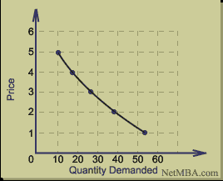
Why does the Qd change?
Consider what happens when Oakland apartment rents increase:
Substitution effect: Consumers can switch to close substitutes when prices rise.
Income effect: people have less purchasing power (feel poorer) when the price

Slide 4
Prices help allocate resources
Ex: Higher rents would cause some consumers to find a roommate, look in other areas outside Oakland, live with parents, stay in a dorm, live in there car… and some will just pay the higher price but be able to buy less of other stuff.
The Higher price incentivizes people to act in ways that help balance the supply and demand of apartments. If the current prices DON’T cause balance because too few apartments are available, landlords will respond by increasing rents (price) and perhaps increasing the quantity of apartments (maybe by repairing a run-down place to quickly get it operating.

Slide 6
So, there is a relationship between prices and quantities… but how much?
ELASTICITY = RESPONSIVENESS
If demand is said to be ‘elastic’, then consumers respond a lot to it.
Price Elasticity = Consumers responding to changes in price
PED = Responsive to Prices

Slide 7
WARNING
The next slide contains images that contain metaphors that have served as powerful learning devices for hundreds of econ students.
If you have delicate sensibilities, look away.

Slide 8
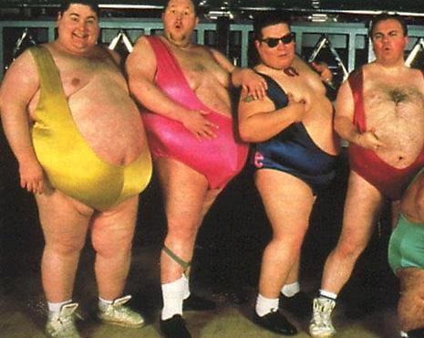
Elasticity = Responsiveness

Slide 9
MEASURING PED
PED = % Change in QD/ % Change P x 100
With PED, ALWAYS ignore minus sign
Scores between 0 & 1 = unresponsive/ Inelastic Demand
Scores above 1 are = more responsive/ Elastic Demand
For most consumer products, scores tend to be from .5 to 1.5, with most near 1 (unit elastic).

Slide 10
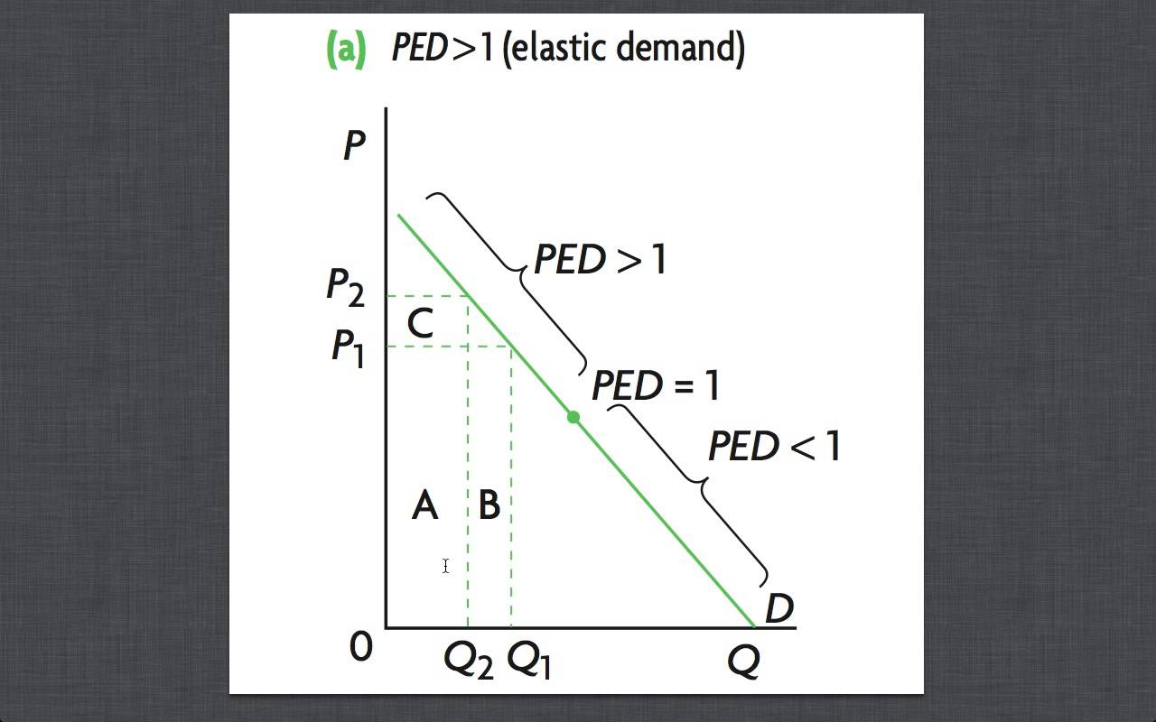
Perfectly Inelastic 0
Unit Elastic 1
Perfectly Elastic Infinite

Slide 13
Which curve is modeling more elastic demand?

Slide 14
What factors influence Demand Elasticity (PED)?
Portion of Income
Ease of Substitution
Is it a necessity or a luxury
Time

Slide 15
INCOME
Income Portion: is the item a small or large part of your income?
Q: If something is a small share of income, is it likely to be price elastic, or price inelastic?
Considering Income, is Milk PED Elastic or Inelastic?
Generally yes, but it depends . Are you are considering middle-class American consumers, milk = inelastic. But for poor Americans or poor humans, milk might be less elastic (more inelastic).

Slide 16
EASE OF SUBSTITION
If you consume a product that is easily replaced…
It’s probably more elastic (less inelastic)
Ex: If the price of gas rises, will EVERYONE drop their keys and grab their bus passes?
Ex: If the price of Mercedes sedans rises, will people purchase a cheaper car? A bus pass? A bike?

Slide 18
Luxury of Necessity?
A need must be fulfilled in a timely manner, while luxury purchases can be delayed without significant sacrifice.
Will people who normally drive to work behave the same if gas prices rise? What if one of them lives just a few miles away and the other one has a 25 minute commute?

Slide 19
Time
When a price changes, our ability to respond depends on how much time we have.
Ex. You and the family woke up early, packed the car and drove two hours to Cedar Point, only to find that prices have doubled. What do you think your family would do?
What would your family do if you learned that prices had doubled a week before your planned trip?

Slide 20
Practice
Create a model that shows possible demand for Cedar point when you have no time to respond, and when you have a week to respond. Label the two curves SR (short run) and LR (long run).
Identify a few items that you/your family considers luxuries that you would delay or reduce your demand for if prices went up.
Model the cigarette market, then show the impact of a sales tax. Show the change in P & Q.

Slide 21
Which is a metaphor for PED Elastic?

Slide 22
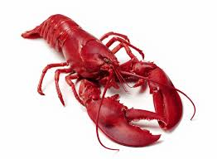
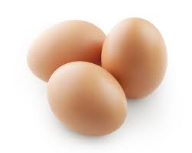
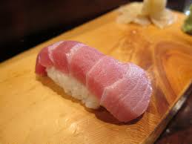
Rank demand for each: most price inelastic to most elastic

Slide 23
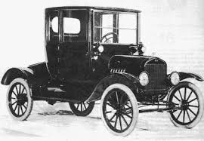
Compared with the other two, which would be a metaphor for something that was unit elastic?

Slide 24
Will it?

Slide 25
Taxes & Price ELASTIC Demand
If:
PED Elastic demand = responsive to price increases
And:
Taxes reduce supply and increase prices
Then:
Taxes will reduce Qd significantly.

Slide 26
TAXES & PRICE INELASTIC DEMAND
IF:
PED Inelastic demand = unresponsive to increased price
AND:
Taxes increase prices.
Then:
Taxes won’t reduce quantity demand much.

Slide 27
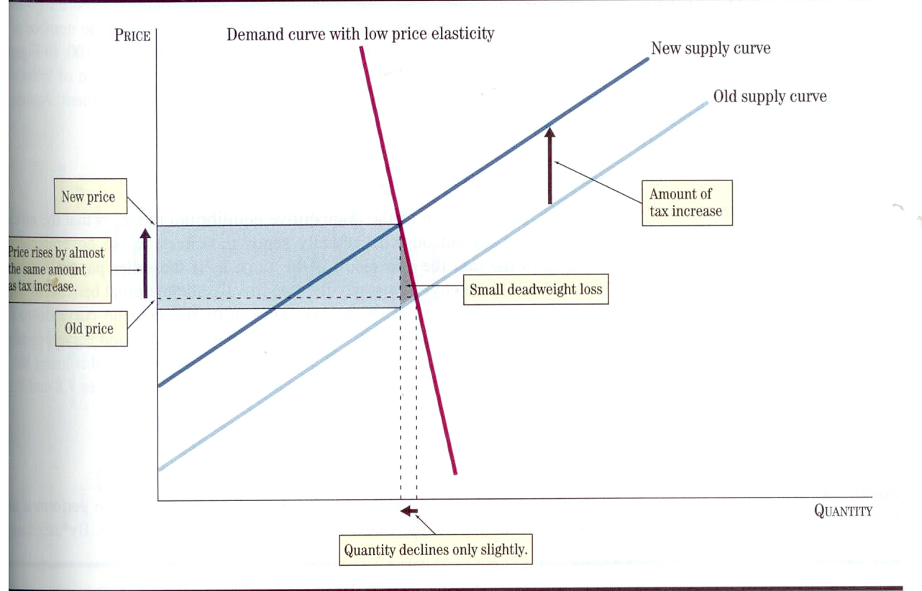
So, why are cigarettes taxed?
Cigarettes do cause harm to the smoker, and society (smokers use more health care, are less productive, and reduce health of those nearby)
Taxes can raise revenue and discourage consumption

Slide 28
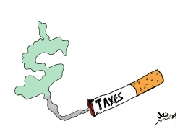
‘Reds’ to 3 tax + PA.
Pennsylvania $ 1.60
3. Rhode Island $3.50
2. Hawaii $3.20
New York 4.35
Estimated external cost to society when a pack of ‘Reds’ is consumed is $.20 cents.

Slide 29
Thank you for smoking? (old data)

Slide 30
Given time, some people DO respond. LR PED is lower.

Slide 31
PED = Responsiveness to Price
Perfectly Inelastic zero
PED Inelastic near zero
Relatively Inelastic/ less elastic < 1
Unit Elastic 1
Relatively elastic/ less inelastic > 1
Elastic > 1
Perfectly Elastic Infinite.
Elasticity = Responsiveness

Slide 32
What else could be taxed to raise revenue or discourage consumption?

Slide 33
What else should be taxed for revenue or discouragement? (careful, this is normative not positive. Politics)
Plastic water bottles to discourage (would probably reduce consumption quite a bit- relatively elastic?? Bev companies would hate it b/c they would face a higher burden of taxes and sales would drop significantly.

Slide 34
INCOME ELASTICITY:
% change Qd/ % change income
>1 = income elastic (Qd rises faster than income)
<1 but positive = income inelastic (Qd rises, but slower than income)
Negative income elasticity = inferior good
Example:
When incomes fall, the Qd of potatoes rises, therefore potatoes are ___________ goods.

Slide 35
CROSS PRICE ELASTICITY
% change in Qd of product A/ % change price of B
Positive= substitutes (burgers and pizza)
Negative = compliments (burgers and fries)

Slide 36
PES
% change Qs/ % change price
Determinates of PES:
Availability of inputs to production.
Time
Excess productive capacity

